Slide 1

Associazione Italiana di Automazione Meccatronica
Viale Fulvio Testi, 128 · 20092 · Cinisello Balsamo (MI) · Italy
Tel. +39 02 24416431 · WWW.AIDAM.IT · MARKETING@AIDAM.IT

Slide 2
ITALIAN ASSOCIATION OF
AUTOMATION AND MECHATRONICS
1999
AIDA WAS BORN
ITALIAN ASSOCIATION OF AUTOMATION
AIDA EVOLVES IN AIDAM
ITALIAN ASSOCIATION OF AUTOMATION AND MECHATRONICS
2011
multidisciplinary field that studies the combination of mechanical engineering, electronic engineering, computer engineering

Slide 3
AIDAM NUMBERS
over
70
600MIL
2.000
Members
turnover
workers

Slide 4



OFFICES
^{ITALY}
^{Viale Fulvio Testi 128}
²⁰⁰⁹²
^{Cinisello Balsamo MI}
^{Tel +39 02 24416431}
^{CZECH REPUBLIC}
^{Husova 159/25}
¹¹⁰⁰⁰
^{Praga 1}
^{Tel +420 222015300}
^{SERBIA}
Production Engineering Department
Faculty of Mechanical Engineering
Kraljice Marije 16 - 11120 Belgrado
^{Tel +381 11 3302435}

Slide 5
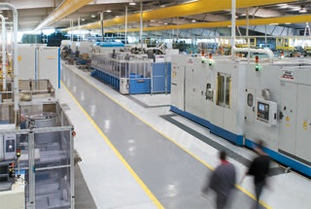
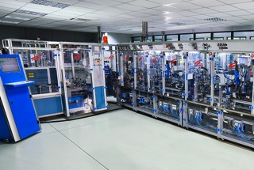
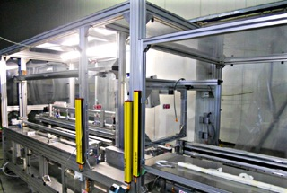
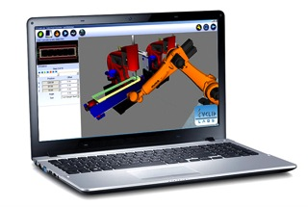
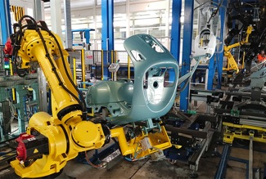
AIDAM MEMBERS
Assembly machines manufacturers
Subsystems manufacturers
Robots providers
vision systems providers

Slide 6
AIDAM MISSION
protect, defend and promote the interests
of our industry-field, highlighting the image
and role AIdAM plays with institutions
share with our Members information and knowledge
support each other in order to promote
the network with useful knowledge for
us and for our Members

Slide 7
AIDAM SERVICES
SIAE
Agreement for the intellectual protection of the Industrial Design
Design for Assembly
ORGANIZATION OF COURSES
contraCTS
SUPPLY AND MAINTENANCE CONTRACTS: GUIDELINES
SERVICING RATES
COMMON PRICE LIST FOR TECHNICAL INTERVENTION
ATECO CODE
International standard for the automation sector
MANUAL FOR ASSEMBLY
DRAFTING AND DIFFUSION
TECHNICAL DICTIONARY
With technical terms and acronyms
MAGAZINE
international specialized magazine on assembly solutions

Slide 8
INTERNATIONALIZATION
CZECH REPUBLIC
creation of a dedicated AIdAM desk at
the Italian-Czech Chamber of Commerce in Prague (September 2016)
SERBIA
ISCP – Italian Serbian Collaboration Platform
Collective participation to the Belgrade Exhibition 2015/2016/2017
TUNISIA
project of ITCP – Italian Tunisian Collaboration Platform
Collective participation to Medindustrie (2015) and CAT (2014)
MOROCCO
Collective participation to Midest Casablanca (2015)
ROMANIA
first mission (February 2016)
IRAN, INDIA
missions scheduled over the next few months
BULGARIA
first contacts already established
PORTUGAL, THAILANDIA, VIETNAM
under consideration
MEXICO/UK
institutional contacts already initiated

Slide 9
WE OFFER
ANSWERS
To your needs
SOLUTIONS
TO YOUR PROBLEMS

Slide 10
BY
Managing all
the technology
on the market
WORKING WITH
PRAGMATISM
PROFESSIONALITY
FLEXIBILITY

Slide 11





AIDAM
PLAYS A KEY ROLE
COLLABORATING WITH institutions
IN ORDER TO ADDRESS the transformation
towards
Industry 4.0

Slide 12
BIG JUMP
TOWARDS A HIGHER LEVEL OF COMPETITION
OPEN INNOVATION
EXPLOIT THE RELATED TECHNOLOGIES AND COMPETENCES
IN FAVOR OF ASSOCIATION
· INDUSTRY 4.0
· COMPETENCE CENTER
· DIGITAL INNOVATION HUB
· KNOW-HOW (INTANGIBLE)

Slide 13
· OVERVIEW
· PRIORITIES
· ADDED VALUE
· FUTURE BUSINESS MODELS
STRONG "REFERENCE POINT"
for INDUSTRY 4.0
POLICY APPLIED
for ANY RELEVANT
TO THE MANUFACTURING
· NATIONAL PLANS AND FISCAL BENEFITS
· INVESTMENTS TO FINANCE R&D PROJECTS

Slide 14
AIDAM
TO FINANCE
THE INNOVATION
EXPLOITS EVERY PLAN DEDICATED
NATIONAL PLAN FOR INDUSTRY 4.0:
SEVERAL INCENTIVES (FISCAL BENEFITS) TO FINANCE R&D AND INNOVATION
OF INDUSTRIAL COMPANIES

Slide 15















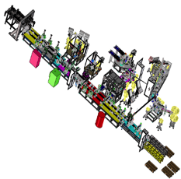




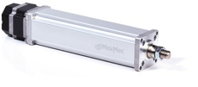

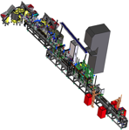
CUSTOMER
ORDER
PURCHASE
ORDER
RAW
MATERIALS
AUTOMATIC RECONFIGURATION
ELECTRICAL ACTUATORS
M2M TECHNOLOGY

Slide 16
THANK YOU
WWW.AIDAM.IT

